Slide 1
Node.js: Getting Started
INTRODUCTION

Slide 2

This Course
Beginner level
No assumptions about Node knowledge Some assumptions about
Basic programming concepts
JavaScript

Slide 3
What is Node.js?

Slide 4
Node.js
JavaScript on your backend servers…

Slide 5
Node.js VM (V8/Chakra)
JavaScript on your backend servers…

Slide 6
Node.js
A wrapper around a VM like V8

Slide 7
Node.js
A wrapper around V8 with built-in modules providing rich features through easy-to-use asynchronous APIs

Slide 8
What exactly is a CALLBACK?

Slide 9
Callback
A function that Node will “call back” at a later point in the time of a program

Slide 10
A callback is just a function
function cb(data) {
// do something with data
}
someAsyncMethod(cb);

Slide 12
Make Me a Latte, Starbucks!
function Steve(readyLatte) {
// drink readyLatte..
}
starbucks.makeMeALatte(Steve);

Slide 13
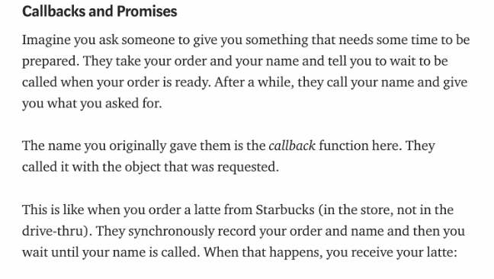

Slide 14
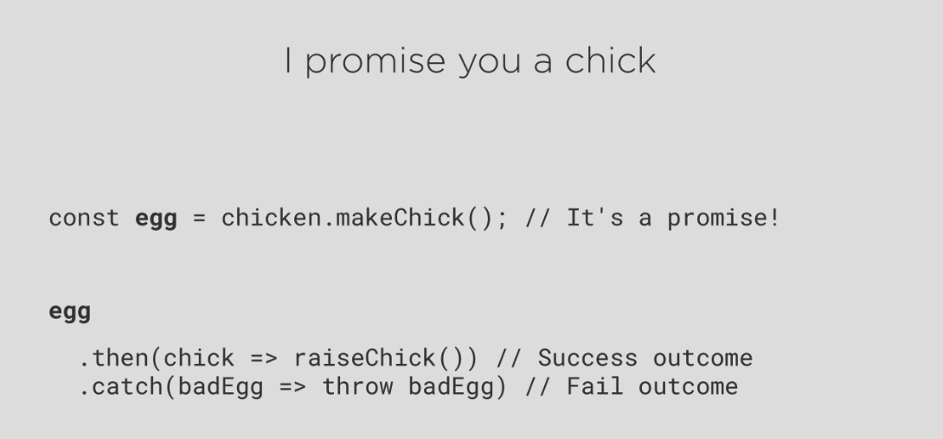

Slide 15
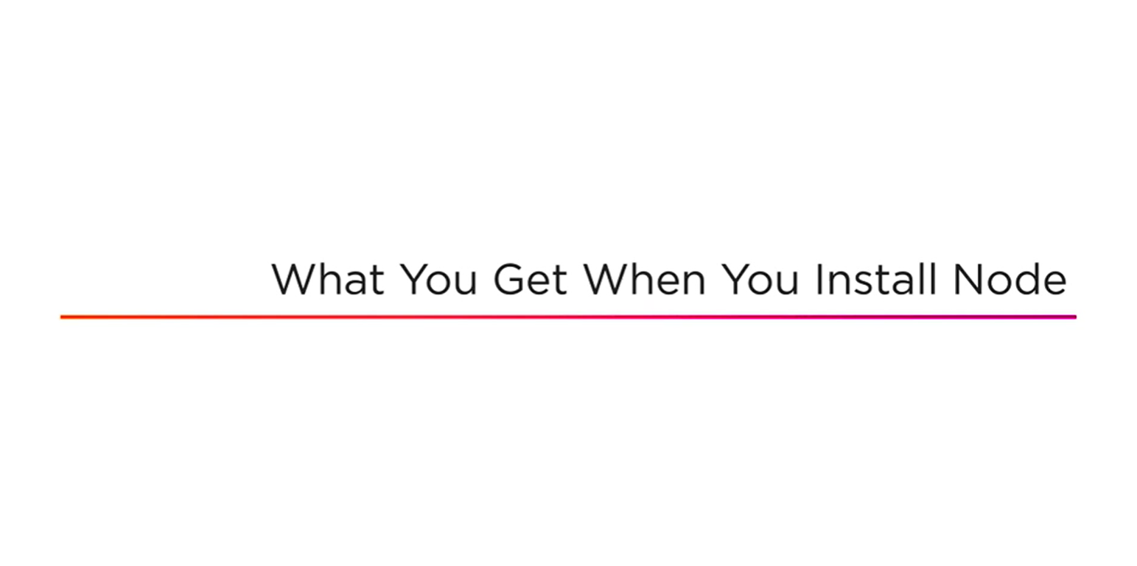

Slide 16
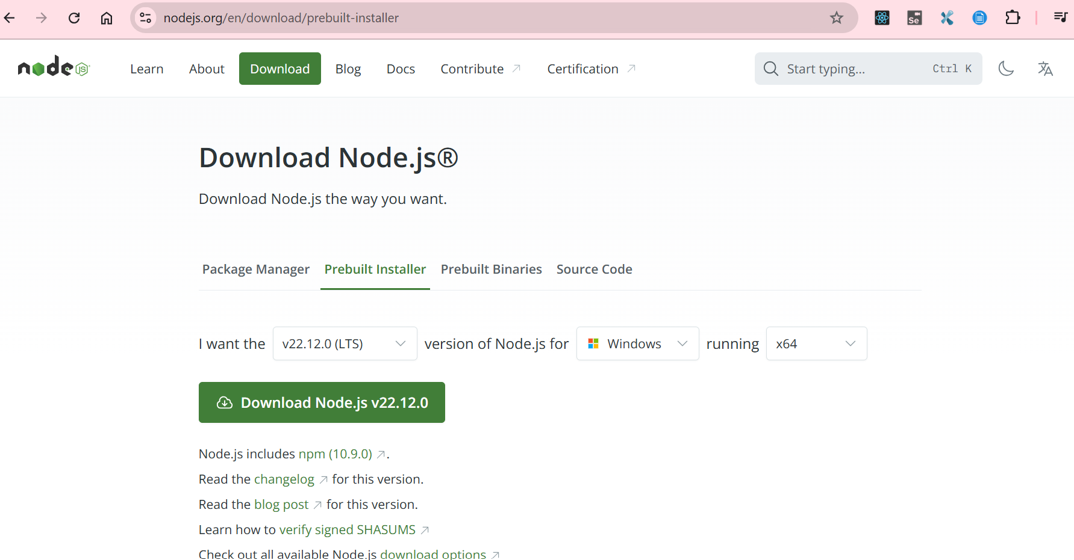

Slide 17
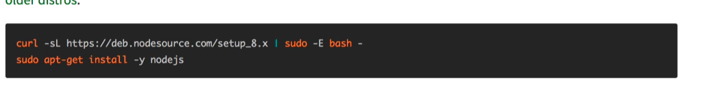
Installing Node on WSL Ubuntu

Slide 18
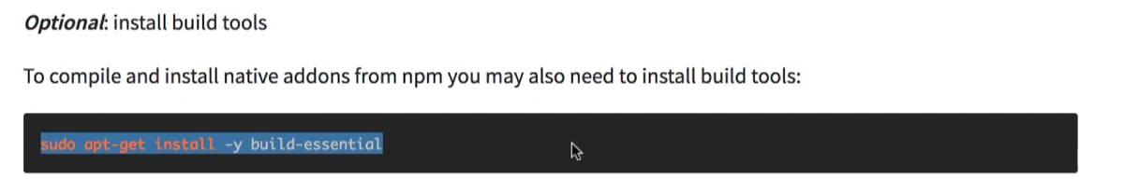
(Optional) Installing Build Tools

Slide 19
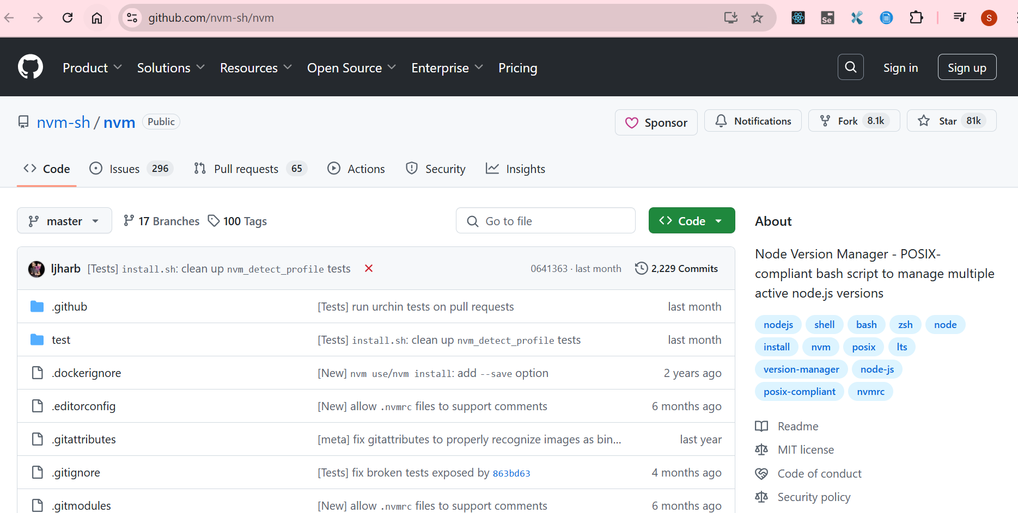

Slide 20
